Slide 1
Ethical Hacking Task -3
By Yashika Shetty
(yashika.shetty_19@sakec.ac.in)

Slide 2
Problem Statement or Task:
In this task you are completely free. http://testasp.vulnweb.com/ - This is the website. Explore the website and try to find vulnerabilities in the website and report it to us. You will be evaluated on your methods and report you submit. Don’t worry about evaluation, just report the vulnerabilities as you feel comfortable.

Slide 3
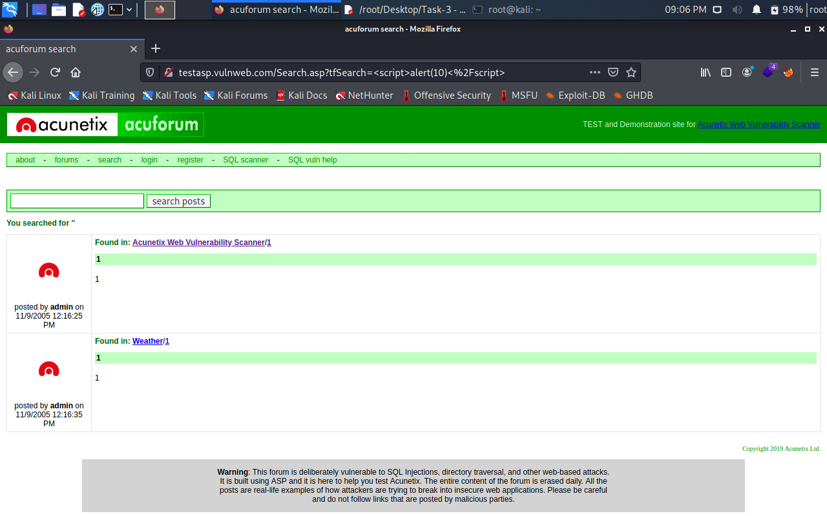
The Findings:

Slide 4
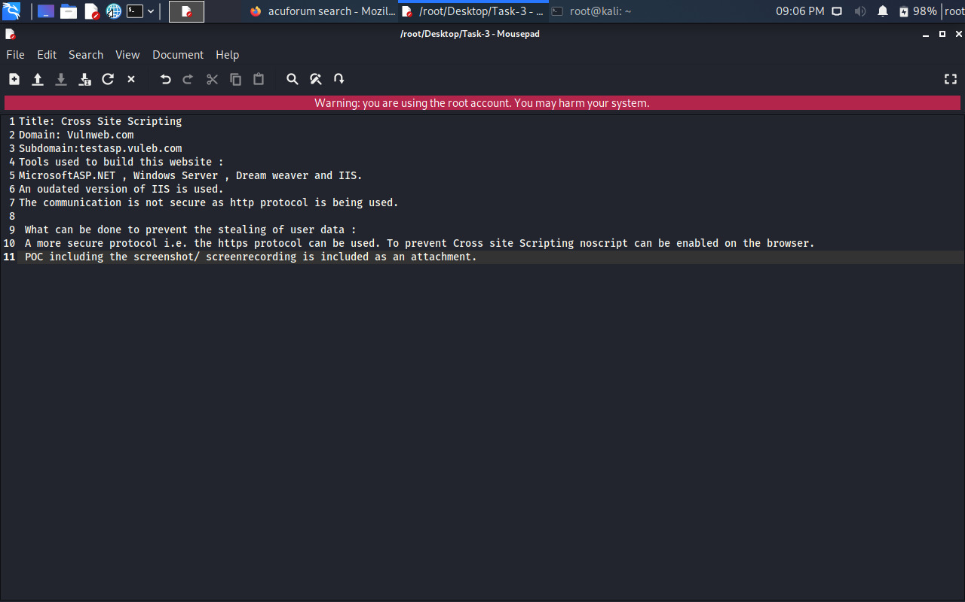
My Report:

Slide 5

Screen recording:
View from drive

